Slide 1
DORMITORY MANAGEMENT SYSTEM
PREPARED BY:
20700051 – Ghalyah Eldandashi
20801513 – Rakhimjon Berdiev
20802777 – Seyedehmahissa Salehnezhad
20803145 – Nazir Alatar
20911068 – Sulaimon Inomov

Slide 2
TABLE OF CONTENTS
01
02
03
04
05
06
INTRODUCTION
DORMITORY DILLEMA
BENEFITS OF THE PROJECT
IDENTIFYING ISSUES AND RISKS
TECHNOLOGY STACK SELECTION
OUR VISION & STRATEGY

Slide 3
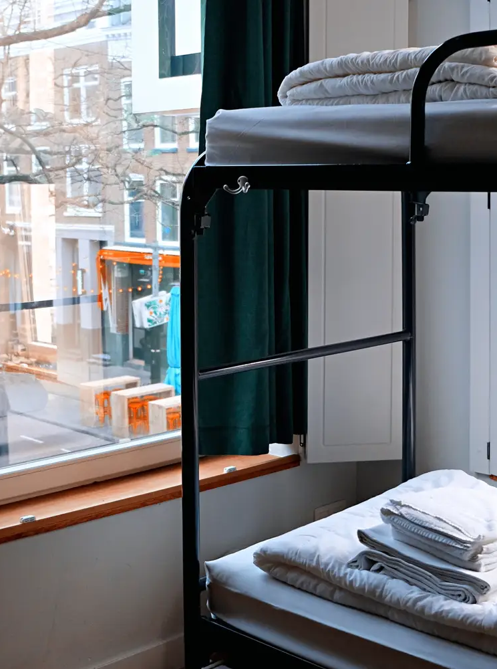
Welcome to the Future of Living in Dorms
Creating Better Places for Students
A Fresh Start for Living on Campus
Easy and Smart Living with Just a Click

Slide 4
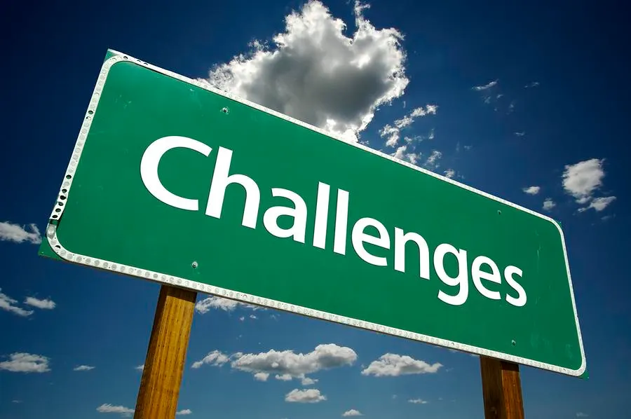
02
Dormitory Challenges

Slide 5

Navigating Current Challenges
From Wait Times to Real-Time: Addressing Inefficiencies
Communication Breakdowns & Maintenance Delays
Transitioning to Digital: A Call for Online Solutions

Slide 6
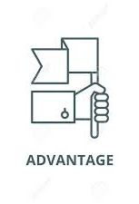
03
Advantages of Our Project

Slide 7
Advantages of Our Digital Solution
Streamlining Daily Life: Automated room bookings, maintenance requests, and notifications.
Enhanced Accessibility: Making dormitory resources and information available at all times.
Empowering Users: Easy access to information and resources, fostering independence and satisfaction.
Enhancing Community: Facilitating communication and engagement among students and staff.
Operational Excellence: Providing administrators with robust tools for efficient management.
Notes:
Making it easier to find what you need and help yourself, leading to happier, more independent living.
Making it easier for everyone to talk and work together.
Giving the people who run dorms powerful tools to make their job easier and better.

Slide 8

04
Identifying Issues and Risks

Slide 9
Identifying Issues and Risks
Getting It Just Right
Technical Expertise
Testing It Out
Making sure we know exactly what features our website needs to help students and staff
Assembling a team with the ideal skills to create a reliable and appealing website
Setting up a test space to find and fix problems, ensuring everything runs smoothly
Keeping It Safe
Time and Resource Constraints
Protecting everyone's personal information and making sure the website is secure against hackers
Keeping the project on schedule and within budget, so we deliver on time without extra costs

Slide 10
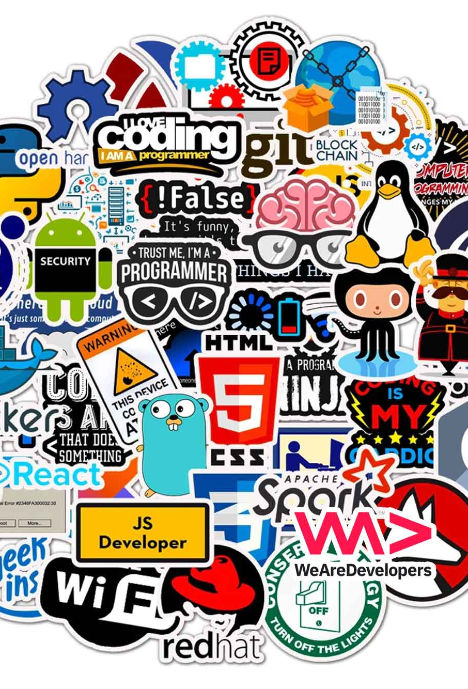
05
Technology Stack Selection

Slide 11

Technology Stack Selection
Planning Tools:
Visual Paradigm: For creating UML diagrams, visualizing system architecture.
MS Word: For comprehensive documentation of project specifics.
Microsoft Visio: For crafting Entity-Relationship Diagrams (ERDs).
Development Tools:
VS Code & PHPStorm: For coding, debugging, and version control.
Azure Hosting: For reliable, scalable web hosting.
Programming Languages:
React.js: For dynamic and responsive user interfaces.
Node.js: For server-side scripting and real-time data management.
MongoDB: For an efficient, JavaScript-based database system.

Slide 12
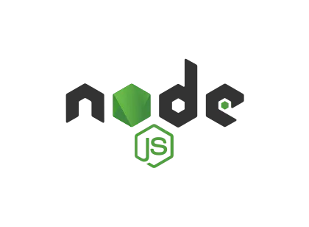


Advantages of the Selected Tools
React.js
Node.js
Fast, dynamic user interfaces with reusable components.
Efficient real-time data handling and easy scalability.
MongoDB
Flexible, scalable database for high-performance needs

Slide 13

06
Vision & Strategy

Slide 14
Vision and Strategy
User-Centric Design: Intuitive and easy navigation for all
Visual and Functional Harmony: Combining looks with practicality
Accessibility and Inclusivity: Accessible to every user
Prototyping and Feedback: Iterating design with user input

Slide 15
Project Orientation Conclusion
Achievements: We've introduced innovative features that make dormitory living and management smoother and more enjoyable.
Lessons Learned: Every challenge has taught us about resilience, innovation, and the value of user feedback.
Next Steps: We're already planning new features and enhancements, continually improving the system.
Vision for the Future: We're committed to evolving with technology and needs, ensuring our system remains at the forefront of dormitory management.

Slide 16

THANK YOU !

